Slide 1
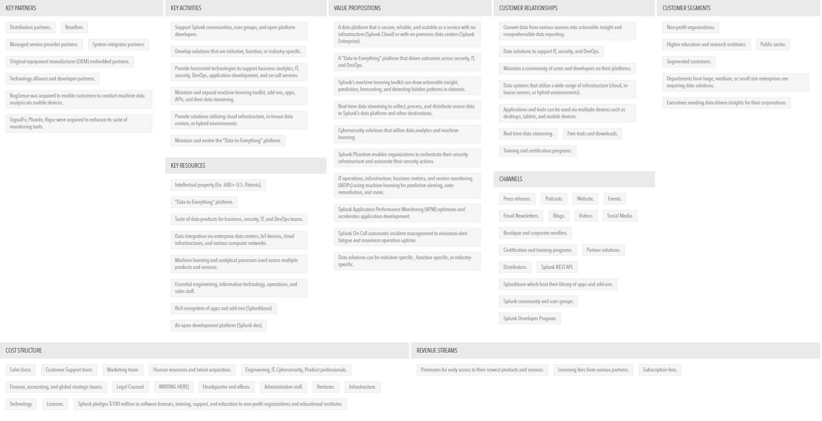
SPLUNK CANVAS
The authority of Business Model Canvas belongs to the company called Strategyzer GA (strategyzer.com). Business strategy generated with vizologi.com

